Slide 1
Connect hearts Fullstack Website

Slide 2
Abstract
The Conneted Hearts Fullstack Website is a modern web application designed to connect individuals seeking marriage through digital profiles and intelligent filtering. The system allows users to register, search, and manage profiles seamlessly.
It integrates a React.js frontend, Spring Boot backend, and MongoDB database, ensuring a responsive, secure, and data-driven platform for matchmaking.

Slide 3
Existing System
Traditional marriage bureaus rely heavily on manual data entry and human matchmaking.
Limited automation, resulting in slow search and filtering.
Paper-based or Excel-based records prone to data inconsistency.
Users have to visit offices physically to view or register profiles.
No data validation or real-time access.

Slide 4
Proposed System
A web-based digital platform for efficient profile registration and search.
Centralized MongoDB database for quick data access.
RESTful APIs via Spring Boot for smooth backend operations.
React.js frontend for an interactive and user-friendly interface.
Smart filters: gender, age, location, profession, religion, etc.
Secure CRUD operations for managing profiles.

Slide 5
Advantages
Fully automated matchmaking system.
Real-time profile search and updates.
Responsive UI accessible from mobile or desktop.
Reduced human effort and paper usage.
Scalable architecture (MongoDB + Spring Boot).
Data validation ensures accuracy and consistency.

Slide 6
Disadvantages
Requires stable internet connection.
No real-time chat or authentication (in current version).
Limited offline accessibility.
Photo uploads depend on storage configuration.

Slide 7
Hardware Requirements
Processor: Intel i5 or higher
RAM: Minimum 8 GB
Storage: 500 GB HDD or higher
Display: 1024x768 resolution or higher
Network: Internet connectivity for API & DB access

Slide 8
Software Requirements
Frontend: React.js, HTML5, CSS3, JavaScript (ES6+), Axios
Backend: Spring Boot, Java 17+, Maven
Database: MongoDB (local or cloud instance)
Development Tools:
• VS Code
• Node.js
• Postman (API testing)
• Mongo DB Compass(for handling the data)

Slide 9
Modules
User Registration Module
Profile Management Module
Search and Filtering Module
Database Management Module
Admin/Moderation Module (Future Scope)

Slide 10
Module Description
1. User Registration: Allows users to create and store personal profiles with details like name, gender, age, religion, profession, etc.
2. Profile Management: Users can view, edit, and delete their profiles securely.
3. Search & Filter: Advanced search with filters for gender, age, location, and profession.
4. Database Management: Stores and retrieves profile data using MongoDB through Spring Data.
5. Admin Module (Future): For managing fake profiles and approving new users.

Slide 11
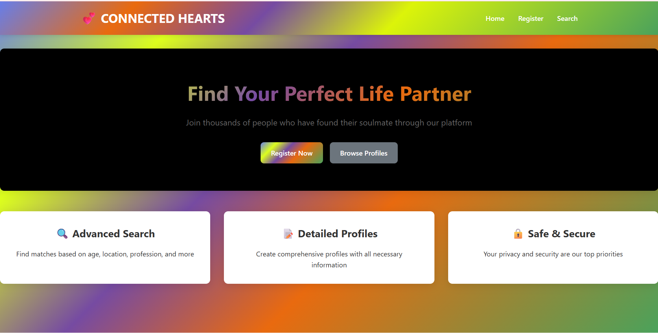
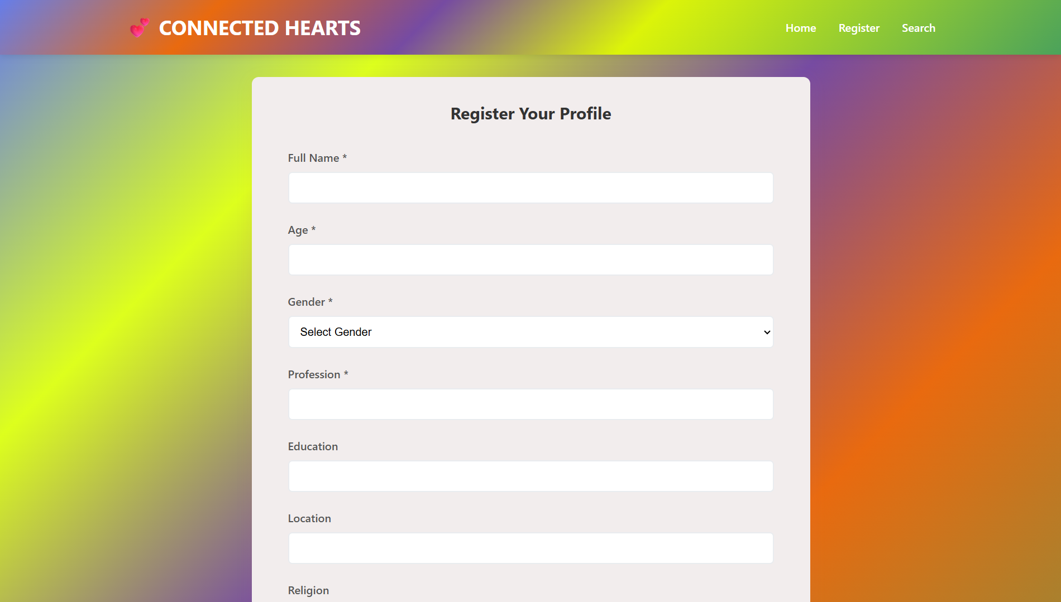
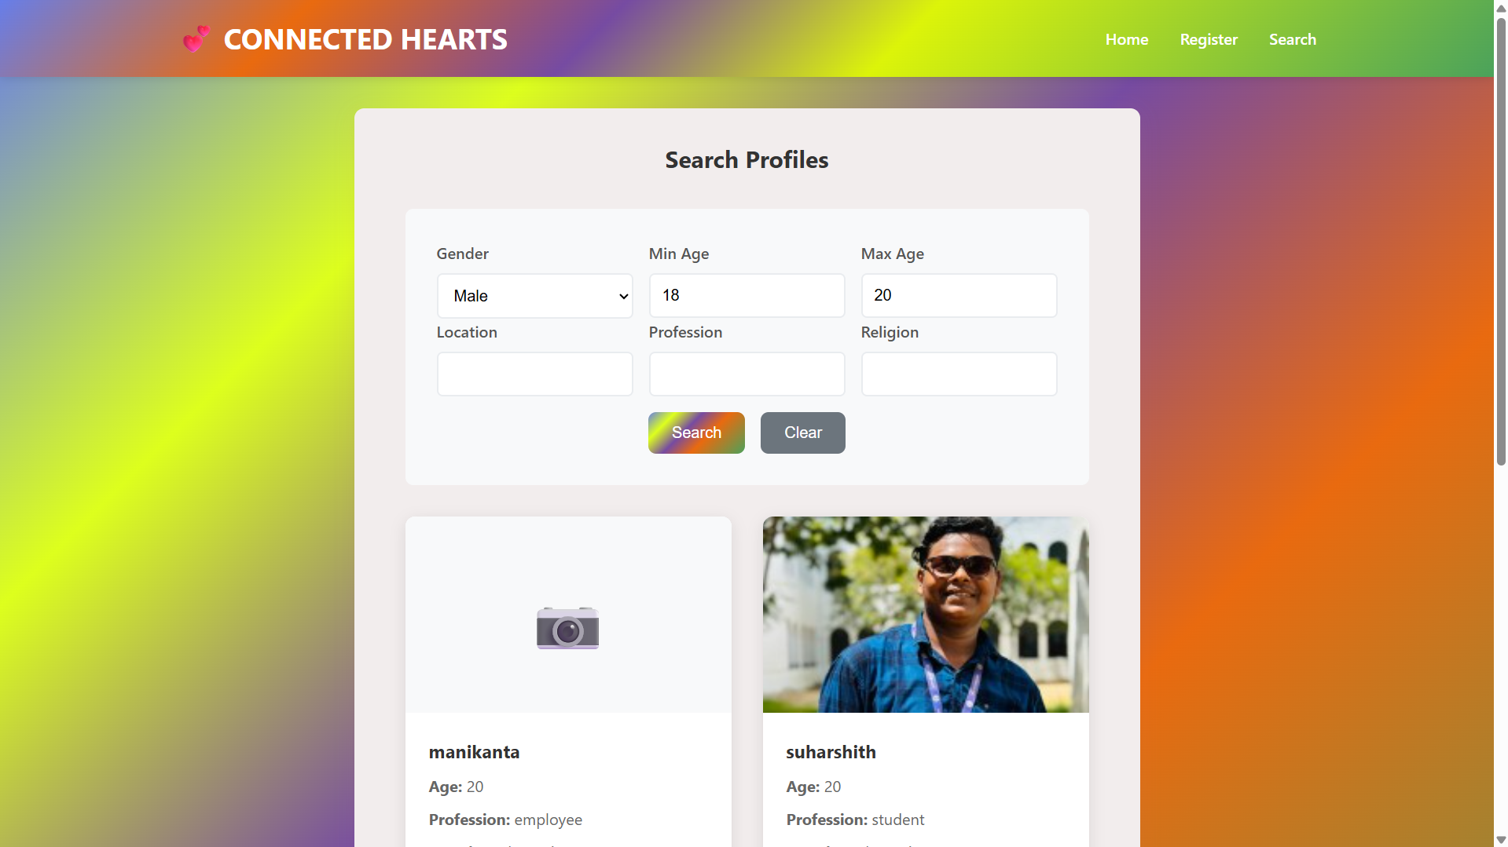
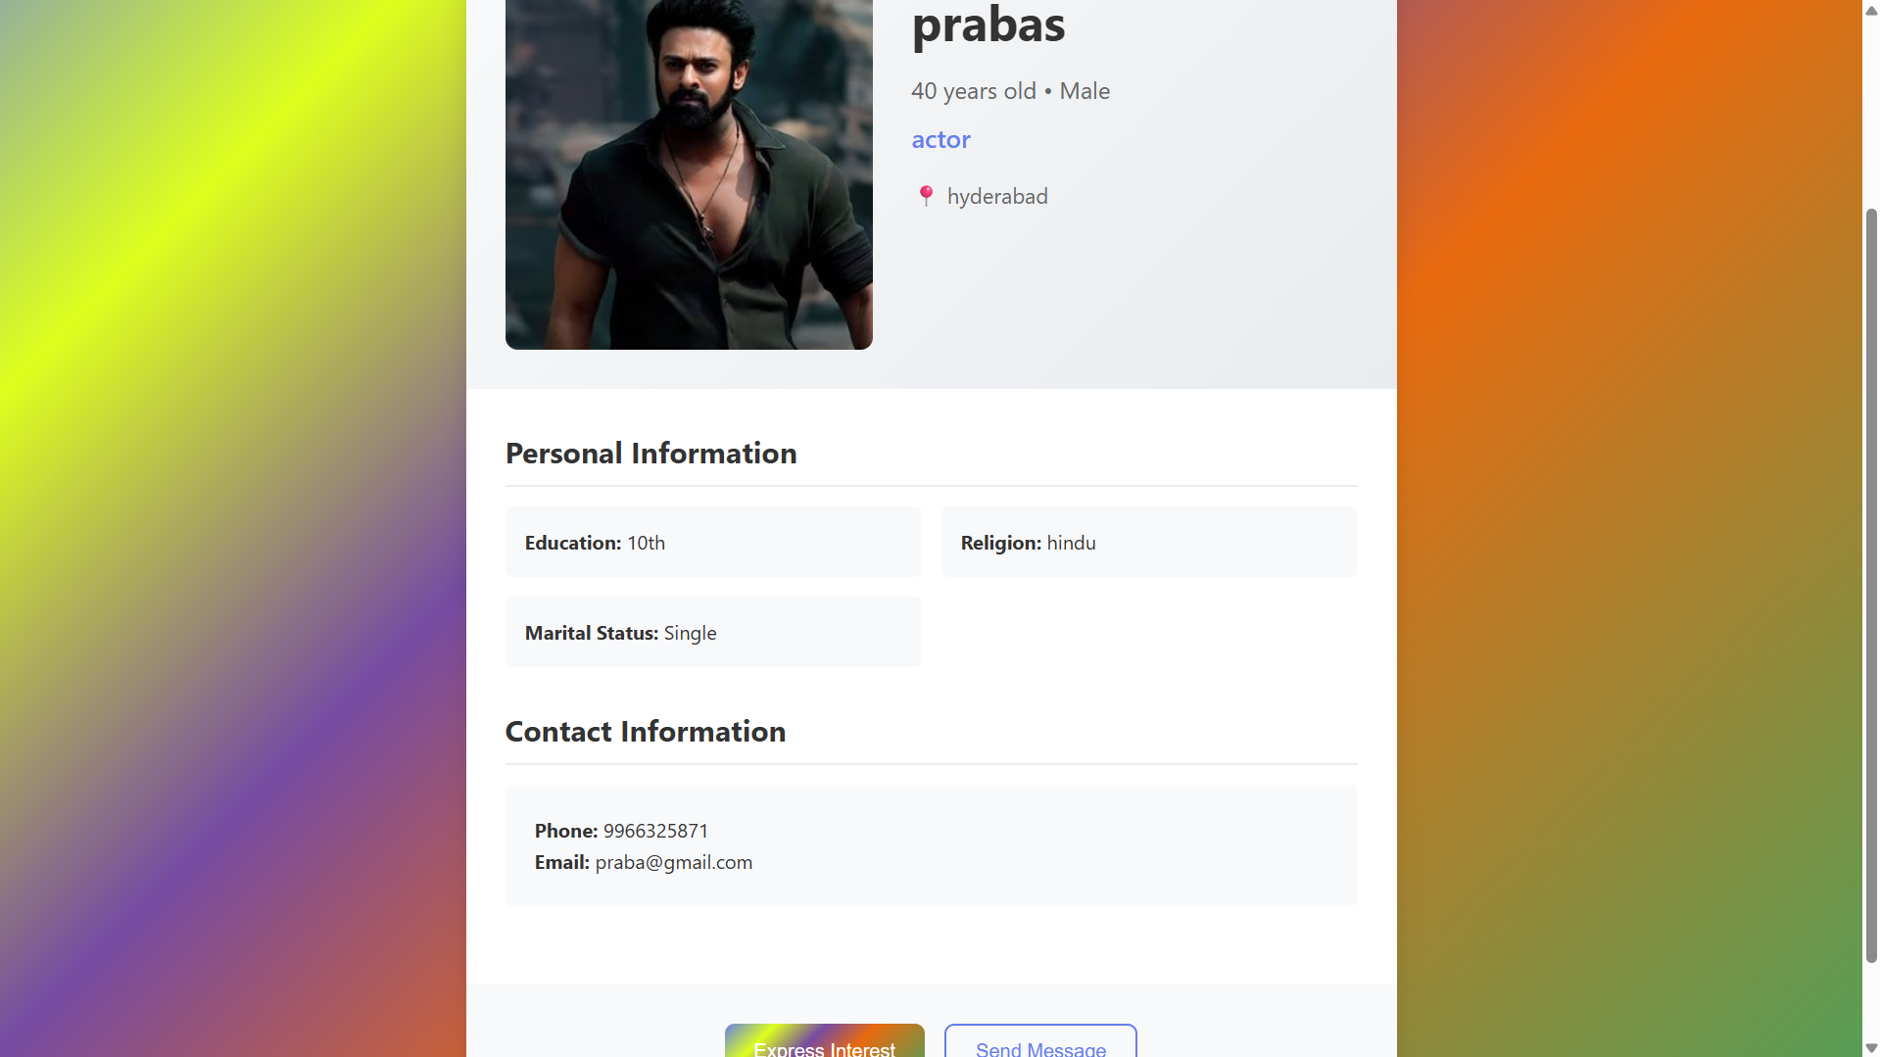
Sample Output (Screenshots)

Slide 12
Conclusion
The Marriage Bureau Fullstack Website effectively digitizes the matchmaking process, offering automation, accessibility, and scalability. It bridges the gap between traditional bureaus and modern web-based matchmaking systems.
Future upgrades will include AI-based matching, chat functionality, and secure authentication, making it a complete end-to-end matrimonial platform.

Slide 13
Thank You

